Slide 1
Fraudulent NEWS DETECTION
Charunya Krishna poola - 16320870
Abhishek reddy narahari - 16320236
Sai Krishna ponugoti - 16320375
Aaslesha madineni - 16329841

Slide 2
Objective
With the increase in usage of social media all around the world, It has become simple for anyone to publish news/articles through their own pages or a specified social media channel. Therefore, with the true news, fraudulent news has also become more popular. In this project, our major focus is to discriminate the fake news among a set of news articles and determine the articles that contain misleading information. In order to achieve our goal, we would make use of machine learning algorithms that provide an approach to the best solution possible.

Slide 3
What Is Machine Learning?
Machine learning algorithms use statistical data to train the models and classify data. In other words, Machine learning enables system to learn from experience without being explicitly programmed. In case of our project, the models which we are going to use must determine the news/text/a piece of article that is given through a webpage is True or False.

Slide 4
Machine Learning Algorithms
Some of the popular algorithms we think would classify better
Naïve Bayes(Bernoulli and Multinomial)
Logistic Regression
Random Forest
Decision Tree

Slide 5
Why Naïve Bayes?
Naïve Bayes work on dependent events.
The probability of an event occurring in the future can be detected from the previous event of same event.
If a few words occur in spam, then the incoming or given content contain same words can be considered false.
References: https://medium.com/analytics-vidhya/email-spam-classifier-using-naive-bayes-a51b8c6290d4

Slide 6
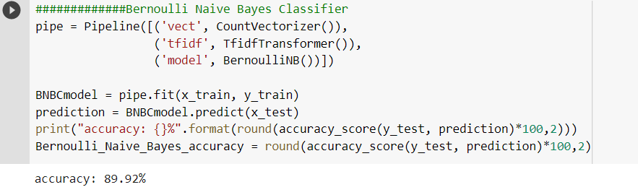
Pipeline is to assemble several operations that can be validated together with different parameters. In our case, three different operations we performed are: CountVectorizer(), TfidfTransformer()
CounVectorizer() – It converts a text (news/content/article) into matrix of word counts.
TfidfTransformer() – Tfidf is to scale down the impact of words that occur very often in each text/content/news.
Performed model – Bernoulli Naïve Bayes – 1. Initialized model, 2. Fit the training dataset into model 3. Performed prediction using test. 4. Found the accuracy score for the given model – Score: 89.92%

Slide 7
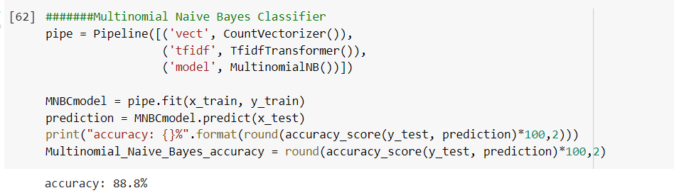
Pipeline is to assemble several operations that can be validated together with different parameters. In our case, three different operations we performed are: CountVectorizer(), TfidfTransformer()
CounVectorizer() – It converts a text (news/content/article) into matrix of word counts.
TfidfTransformer() – Tfidf is to scale down the impact of words that occur very often in each text/content/news.
Performed model – Multinomial Naïve Bayes – 1. Initialized model, 2. Fit the training dataset into model 3. Performed prediction using test. 4. Found the accuracy score for the given model – Score: 88.8%

Slide 8
Why Logistic Regression?
Logistic Regression produces results of the operations like word count, character count, minimum and maximum operations.
It defines the interdependency between dependent and independent variables.
On the given distribution of data, it performs some basic tests like finding and calculating mean and standard deviation.

Slide 9
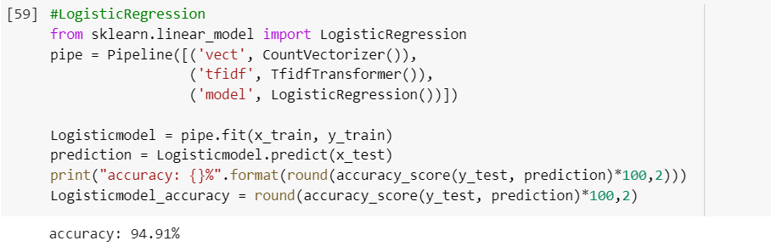
Pipeline is to assemble several operations that can be validated together with different parameters. In our case, three different operations we performed are: CountVectorizer(), TfidfTransformer()
CounVectorizer() – It converts a text (news/content/article) into matrix of word counts.
TfidfTransformer() – Tfidf is to scale down the impact of words that occur very often in each text/content/news.
Performed model – LogisticRegression – 1. Initialized model, 2. Fit the training dataset into model 3. Performed prediction using test. 4. Found the accuracy score for the given model – Score: 94.91%

Slide 10
Why Random Forest?
Random Forest is a meta-learner which consists of many individual trees.
Each tree votes on overall satisfaction and the algorithm chooses the classification with most votes.
If identified category is 0, then the news is false, if not, the news is true when identified category is 1.
References: http://www.irdindia.in/journal_ijacect/pdf/vol2_iss4/1.pdf

Slide 11
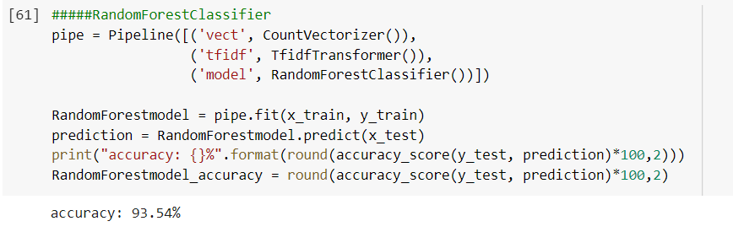
Pipeline is to assemble several operations that can be validated together with different parameters. In our case, three different operations we performed are: CountVectorizer(), TfidfTransformer()
CounVectorizer() – It converts a text (news/content/article) into matrix of word counts.
TfidfTransformer() – Tfidf is to scale down the impact of words that occur very often in each text/content/news.
Performed model – RandomForest – 1. Initialized model, 2. Fit the training dataset into model 3. Performed prediction using test. 4. Found the accuracy score for the given model – Score: 93.54%

Slide 12
Why Decision Tree?
Decision tree decides the target value (dependent variable) of a new sample based on various attribute values of the available data.
The predicted attribute is known as the dependent variable, since its value depends upon, or is decided by, the values of all the other attributes.
Terminal nodes denote the final value (classification) of the dependent variable.
References: https://arxiv.org/pdf/1310.5963.pdf

Slide 13
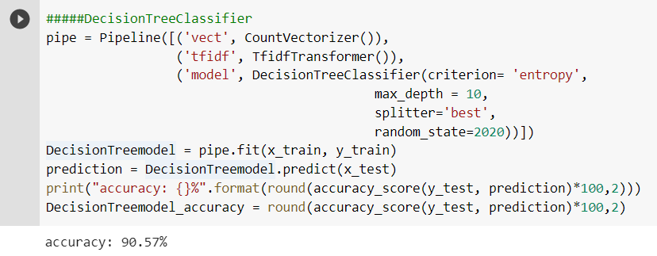
Pipeline is to assemble several operations that can be validated together with different parameters. In our case, three different operations we performed are: CountVectorizer(), TfidfTransformer()
CounVectorizer() – It converts a text (news/content/article) into matrix of word counts.
TfidfTransformer() – Tfidf is to scale down the impact of words that occur very often in each text/content/news.
Performed model – DecisionTree– 1. Initialized model, 2. Fit the training dataset into model 3. Performed prediction using test. 4. Found the accuracy score for the given model – Score: 90.57%

Slide 14
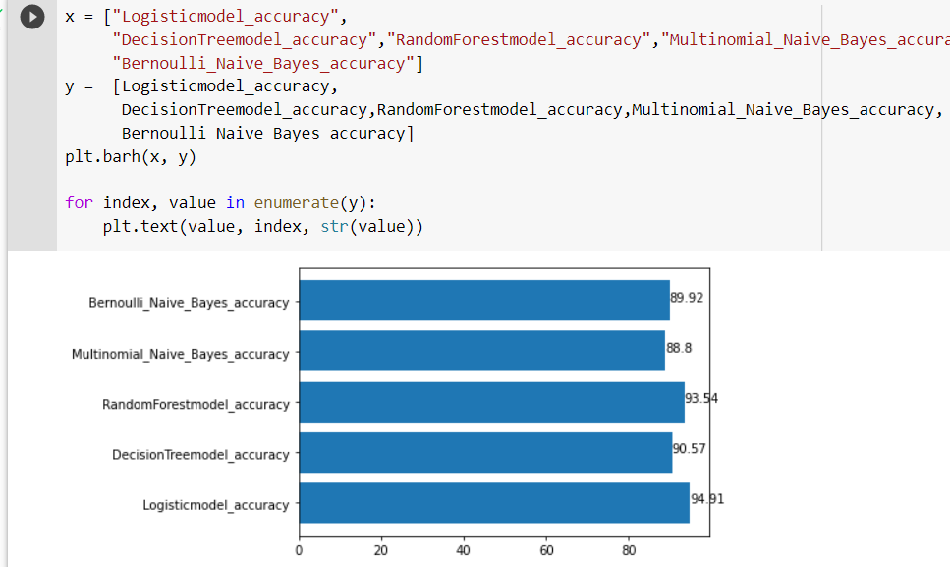
Comparison of Accuracy Scores and Finding the Optimal one Returned Through the above Algorithm.
From the above screenshot, it is clear that LogisticRegression returned the best score of all.

Slide 15
UI Design
We designed a simple webpage that accepts the content/news/article and return with the classified result which could be True or False.
We created the webpage using HTML5 and CSS and Flask. Flask is a framework that helps us to build web applications and gives us the necessary tools and libraries.
By using the saved model (Logistic Regression), we predict the class of the text/news/articles and send the results back to the webpage.
Logistic Regression Classifier is because, when performed prediction, it has given us the best accuracy score.

Slide 16

This is the webpage which accepts the content/news/text from the user and upon clicking on submit button, our model performs the classification on the provided text into either True or Fake.

Slide 17

As seen in the above screenshot, we have provided some text and our model predicted it as True news, which is accurate.

Slide 18

As seen in the above screenshot, we have provided some text and our model predicted it as Fake news, which is accurate, too.

Slide 19
References
Kaggle - https://www.kaggle.com/jruvika/fake-news-detection
Kaggle - https://www.kaggle.com/mrisdal/fake-news
Yang, Y., Zheng, L., Jiawei, Z., Cui, Q., Li, Z., & S. Yu, P. (2018). TI-CNN: Convolutional Neural Networks for Fake News Detection. arXiv:1806.00749 [cs.CL].
Jamal , A., Osama , S., & IraklisVarlamis, V. (2021). Fake news detection: A hybrid CNN-RNN based deep learning approach. International Journal of Information Management Data Insights.

Slide 20
Thank You!

